Slide 1
Array week 2
2020 Spring Coding Class
By - Saeyeon Kim

Slide 2
Open your hw for the last class and make a copy of the class notes
link:https://docs.google.com/document/d/1EiGg4pFJH31nXWNoDyHCYg-vPvsuPU5yAKnKhoP3nLg/edit

Slide 3
The ArrayList
ArrayList<String>
ArrayList<Integer>
Creating an Arraylist
1. import java.util.ArrayList;
2. ArrayList<type > name = new ArrayList<type >();
Ex . ArrayList<String > spongebob = new ArrayList<String >();

Slide 4
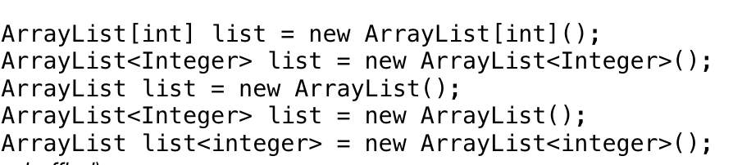
PICK THE CORRECT ANSWER CHOICE
A
B
C
D
E

Slide 5
Add values into an ArrayList
spongebob.add(“Patrick Star”);
Name of an arraylist variable
spongebob.add(“Pikachu”);
spongebob.add(“Mr. Krabs”);
In the spongebob arraylist:
[Patrick Star, Pikachu, Mr. Krabs]
0
1
2
0
1
2

Slide 6
Remove values an ArrayList
spongebob.remove(1);
index of the variable
Name of an arraylist
In the spongebob arraylist:

Slide 7
Remove values an ArrayList
Before: {Patrick Star, Pikachu, Mr. Krabs}
spongebob.remove(1);
After : - what will happen to “pikachu”
- what will happen to “Mr.Krabs”
0
1
2
[Patrick Star, Mr. Krabs]
0
1

Slide 8
Add method 2
variable
spongebob.add(1,”gary”);
index of the variable
Name of an arraylist
Before: [Patrick Star, Mr. Krabs]
After: [Patrick Star, gary, Mr. Krabs]
0
1
???

Slide 9
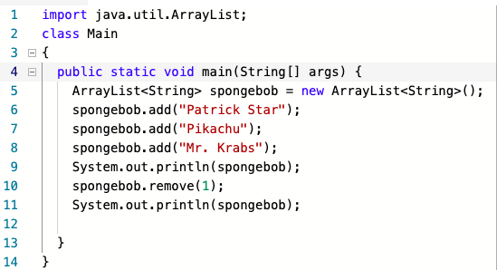
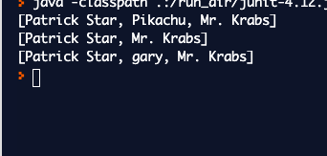
If you finish and get a check from the instructor, tilt your laptop.
Exercise 1. Type the following code.
Output :

Slide 10
Get a value from an ArrayList
spongebob.get(0);
index of the variable
Name of an arraylist
RESULT : “Patrick Star”
[Patrick Star, gary, Mr. Krabs]
ArrayList did not change

Slide 11
Set a value in an ArrayList
variable
spongebob.set(2,”plankton”);
index of the variable
Name of an arraylist
Before: [Patrick Star, gary, Mr. Krabs]
After: [Patrick Star, gary,plankton]

Slide 12
Get a size of an ArrayList
Get a size of an array : name.length();
spongebob.size();
Nothing
RESULT : 3 , because there are 3 values in an arraylist
Don’t confuse with the index!
[Patrick Star, gary, Mr. Krabs]
ArrayList did not change

Slide 13
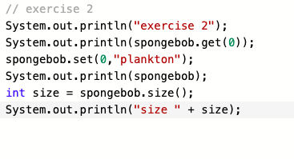
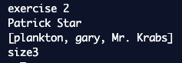
If you finish and get a check from the instructor, tilt your laptop.
Continue ~~~ from the first exercise
Output :

Slide 14
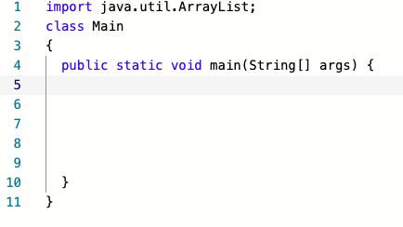
Exercise # 3
Create your own ArrayList
Use 3 methods from the table (If you finish early, use 6 methods!)
At least three output should be printed !
Make a new file or clear everything inside the main()

